Slide 1
Outline
Epidemiology of infection
Nosocomial infections (NIs) /Healthcare-associated infections (HAIs)

Slide 2
Epidemiology of infection
Study of determinants, occurrence, and distribution of health and disease in a defined population
Infection is a replication of organisms in host tissue, which may cause disease.
Epidemiologic studies (Methods)
Descriptive, organizing data by time, place, and person
Analytic, incorporating a case-control or cohort study; or
Experimental: manipulate cause and note effect

Slide 3
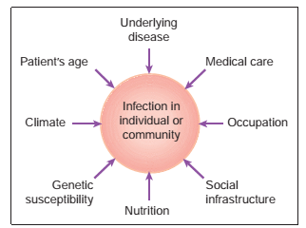
Factors affecting epidemiology of infections

Slide 4
Definitions
Incidence rate:
Number of new cases of acute disease in a specified population over a defined period
Expressed as a proportion of total population studied
Prevalence rate:
Total number of cases present in a defined population at a certain time point or over a certain period.
Prevalence exceeds incidence.
Attack rate:
Proportion of total population at risk, who became infected during an outbreak.

Slide 5
Microorganisms that have ability to cause disease are called pathogens.
Infection occurs when a pathogen is able to establish itself in a person.
Not all infections, however, result in clinical infection (sub-clinical)
The infectiousness or communicability of an organism refers to its capacity to spread.
Epidemiology is study of spread, distribution, prevalence, and control of disease in a community.

Slide 6
The spectrum of occurrence of disease in a defined population includes
Sporadic (occasional occurrence)
Endemic (regular, continuing occurrence): Malaria
Epidemic (significantly increased occurrence) and
Pandemic (epidemic occurrence in multiple countries)
HIV disease, influenza, cholera and COVID-19

Slide 7
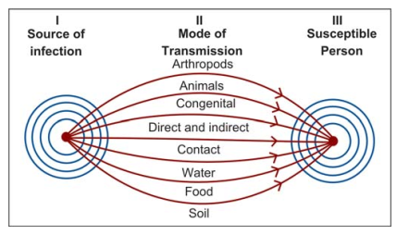
Chain of infection
Includes three factors that lead to infection:
Etiologic agent
Method of transmission, and
Host
Fig. Sources and vehicles of infections

Slide 8
1. Etiologic Agent
Any microorganism that can cause infection
Pathogenicity of an agent is its ability to cause disease
Describing organism's virulence and invasiveness.
Virulence refers to severity of infection
Morbidity: incidence of disease
Mortality: death rate of infection
Invasiveness of an organism refers to its ability to invade tissue (Toxin)
Infecting dose: number of organisms necessary to cause disease
Specificity (S. typhimurium vs S. typhi)

Slide 9
Cont.
Reservoir of an organism is a site where it resides, metabolizes, and multiplies
The reservoir and source can be different/same

Slide 10
2. Method of Transmission
Means by which agent goes from source to host.
The four major methods of transmission are by
Air: droplet nuclei or dust
Contact- Direct /Indirect/ airborne droplets
Common vehicle: Food, water, medication, solution
via a vector: arthropods

Slide 11
3. Host
The organism may enter host through:
Skin, mucous membranes
Lungs
Gastrointestinal tract
Genitourinary tract, and
Enter fetuses through placenta
Non-specific defense mechanisms vs Specific defense mechanisms

Slide 12
Sources of infection
Endogenous
Exogenous:
Humans: Typhoid carriage in gall bladder/ S. aureus: nose
Animals: human infections acquired from animals-zoonoses
Environment: soil and water (e.g. Clostridium tetani; Aspergillus spp, Legionella spp)

Slide 13
Routes of spread of infection
Airborne spread can occur via:
Droplets
Respiratory infection: influenza virus, MTB, SARS-Cov-2
Ventilator nebulisers: P. aeruginosa
Air-conditioning systems: Legionella pneumophila
Shed squamous epithelial cells: staphylococci
Aerosolised spores: Aspergillus fumigatus from contaminated air-handling plants.

Slide 14
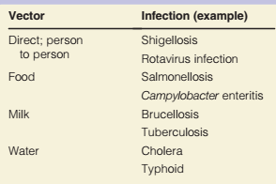
Cont.
Contact transfer
Table: Examples of oral transmission of infectious agents

Slide 15
Cont.
Vertical transmission
Transmission from mother to foetus/baby
Blood borne transmission in utero via placenta e.g. rubella or via
Contact transmission in birth canal during delivery (e.g. HSV, HIV).
Direct inoculation (injection)
e.g. needles, infusions (drugs, blood, fluids), tick or mosquito bites

Slide 16
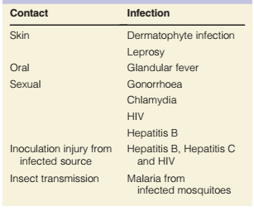
Table: Examples of transmission by direct contact or transfer

Slide 17
Factors affecting transmission of microbes
Survival in environment
Establishment on new host

Slide 18
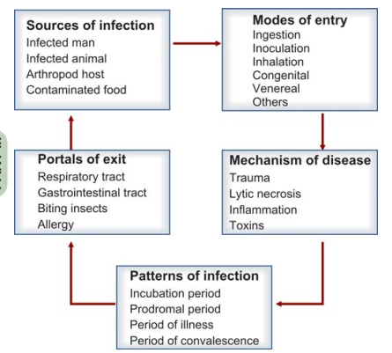
Fig. Dynamics of infection

Slide 19
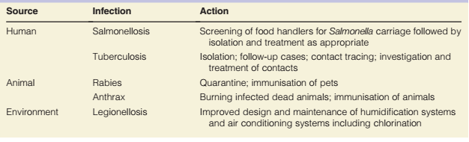
Key strategies to prevent infections
1. Reduce or eliminate exposure to sources of infection

Slide 20
Cont.
2. Prevent transmission of infection
Airborne: Isolation of patients
Water: Separate sewage from drinking water and provision of potable water.
Food: Refrigeration/Separate storage, cooking and reheating
Direct and contact transfer:
Good personal hygiene and isolate patients: Faco-oral
Safe sex, contact tracing and health education campaigns: STI
Blood-born protection: safe sharps practice, provision of sterile needles

Slide 21
3. Increasing host resistance
Immunisation
4. Antimicrobial prophylaxis
Preoperative
Immunocompromised patients: AIDS
Transplant patients to prevent CMV infection
Short-term for travellers : Anti-malaria

Slide 22
Nosocomial infections

Slide 23
Nosocomial infections/NI
Hospitals: places that help people in getting cured of illnesses
Also as transmitters of diseases
Infections that are acquired in hospitals -hospital infections or NIs.
Nis:
Infections which develop during hospitalization ((at least 2 days after admission) and
Not incubating or present at time of admission to hospital.

Slide 24
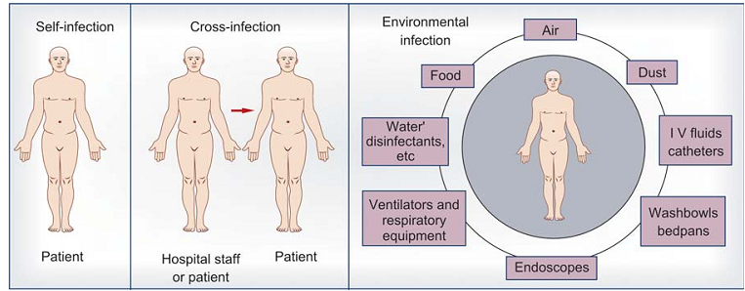
Source of Infection
Exogenous: Human, animal or environments
Another patient or a member of hospital staff or
Inanimate environment in hospital
Endogenous: patient’s own flora
Fig. Acquisition of hospital infections

Slide 25
Persons at Risk
HAIs affect:
Discharged
Inpatients
Outpatients
Hospital staff and
Subsequently it may spill over in community.

Slide 26
Predisposing Factors for NIs
Hospital environment
Hospital microbial flora
Instrumentation in hospitals
Blood, blood products and intravenous fluids
Accidental inoculation of infectious material

Slide 27
Modes of Spread
Various modes of spread of nosocomial infections are:
Airborne
Infection by contact
Infections acquired from food
Infections associated with water
From hospital equipment
Infections by inoculation.

Slide 28
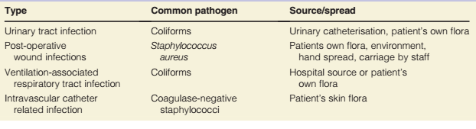
Common Type and Agents of NIs
Wound infections: S.aureus, P.aeruginosa
Urinary tract infections: E. coli
Respiratory infections
Skin infections
Bacteraemia and septicaemia
Gastrointestinal infections
SARS-CoV-2

Slide 29
Control and Prevention
Hand washing
Intelligent use of instrumentation
Limitation of use of antibiotics
Prophylactic antibiotics in specific situations for short periods
Limitations of transfusions
Barrier precautions
Surveillance
Frequent change of intravenous lines

Slide 30
Infection Committee
It is essential to establish an infection committee in the hospital which should consist:
Physicians
Nurses
Administrators and
Laboratory personnel
The committee should meet regularly and frequently and decide about hospital policy related to infection control.

Slide 31
Biological warfare
Use of biological toxins or infectious agents with intent to kill, harm or incapacitate humans, animals or plants as an act of war.
Plans need to be in place, both in hospitals and community
In case of contamination with biological material, including smallpox and anthrax.
Precautions include;
Appropriate protective clothing,
Prophylaxis and
Immunization

